Slide 1
Lending Club Case Study
Group Members :
Indrashis Chatterjee
Ranjan Choudhury

Slide 2
Problem Statement
The company is the largest online loan marketplace, facilitating personal loans, business loans, and financing of medical procedures. Like most other lending companies, lending loans to ‘risky’ applicants is the largest source of financial loss (called credit loss).
The aim is to identify patterns which indicate if a person is likely to default, which may be used for taking actions such as denying the loan, reducing the amount of loan, lending (to risky applicants) at a higher interest rate, etc.
In other words, the company wants to understand the driving factors (or driver variables) behind loan default, i.e. the variables which are strong indicators of default. The company can utilise this knowledge for its portfolio and risk assessment.

Slide 3
Business Understanding
You work for a consumer finance company which specializes in lending various types of loans to urban customers. When the company receives a loan application, the company has to make a decision for loan approval based on the applicant’s profile. Two types of risks are associated with the bank’s decision:
If the applicant is likely to repay the loan, then not approving the loan results in a loss of business to the company
If the applicant is not likely to repay the loan, i.e. he/she is likely to default, then approving the loan may lead to a financial loss for the company

Slide 4
Business Understanding
When a person applies for a loan, there are two types of decisions that could be taken by the company:
Loan accepted: If the company approves the loan, there are 3 possible scenarios described below:
Fully paid: Applicant has fully paid the loan (the principal and the interest rate)
Current: Applicant is in the process of paying the instalments, i.e. the tenure of the loan is not yet completed. These candidates are not labelled as 'defaulted'.
Charged-off: Applicant has not paid the instalments in due time for a long period of time, i.e. he/she has defaulted on the loan
Loan rejected: The company had rejected the loan (because the candidate does not meet their requirements etc.). Since the loan was rejected, there is no transactional history of those applicants with the company and so this data is not available with the company (and thus in this dataset)

Slide 5
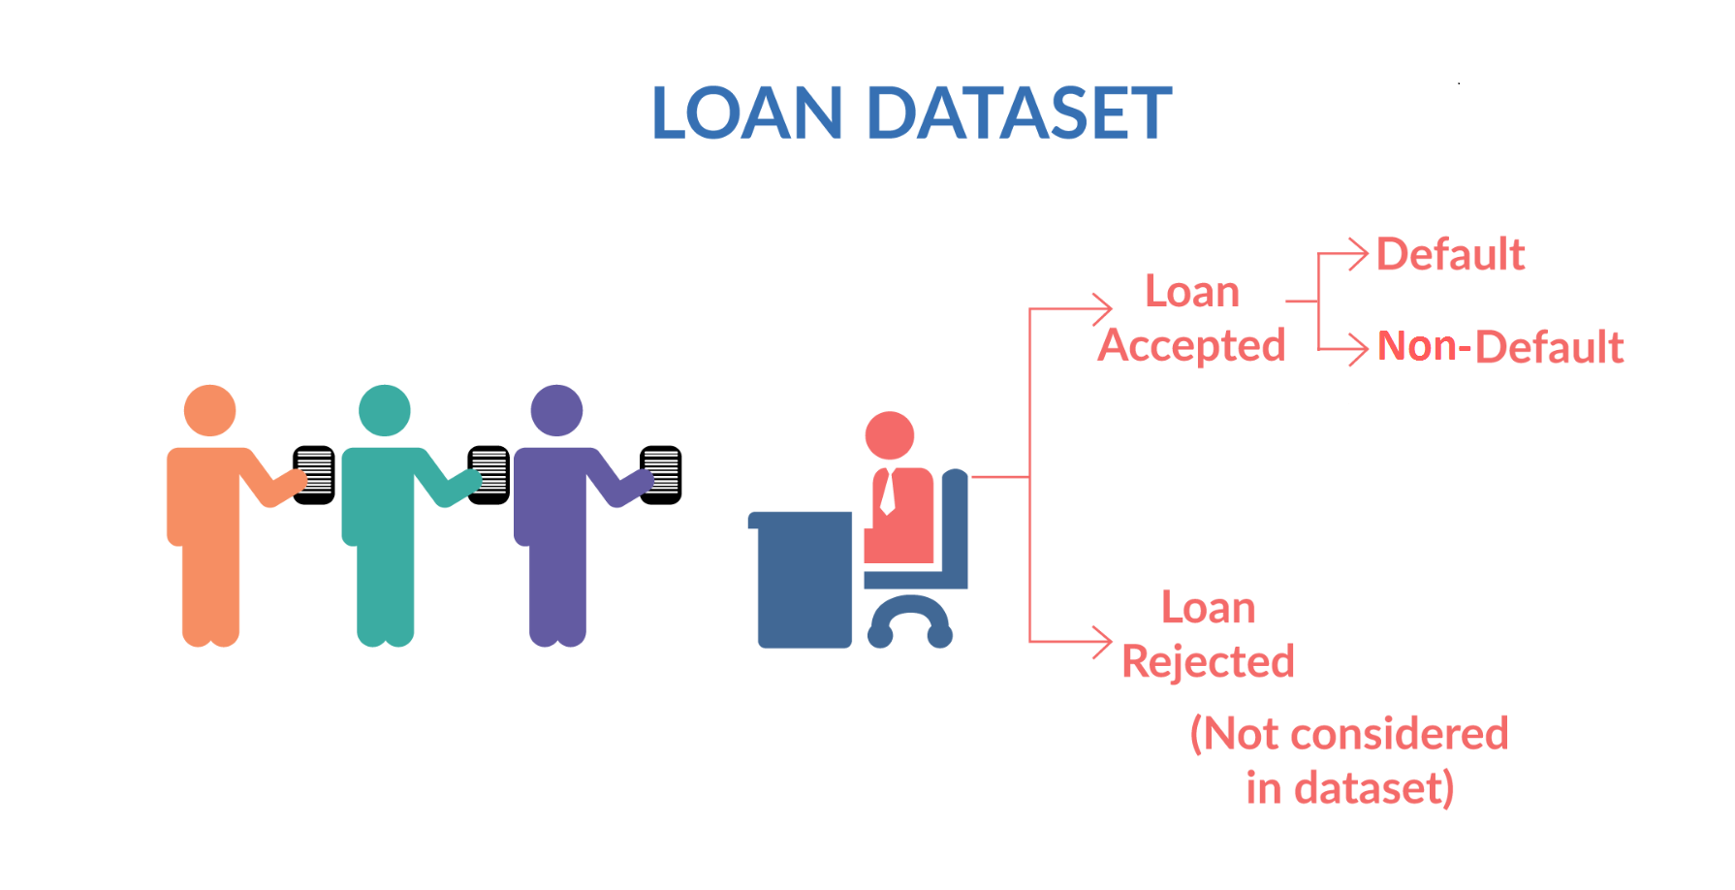
Business Understanding

Slide 6
Methodology
Data Understanding
Data
Cleaning
Univariate Analysis
Univariate Segmented Analysis
Conclusion
Bivariate Analysis

Slide 7
Data Understanding & Cleaning
The provided data had a lot of null values. Columns with more than 60% null have been dropped and are also imputed wherever applicable
Few of the columns had malformed data. Those were standardized.
Business driven, data driven and type driven derived columns are created as required.
Checked for duplicate data throughout if any in the dataset. There were no duplicate rows
After understanding and cleanup, proceeded with data analysis

Slide 8
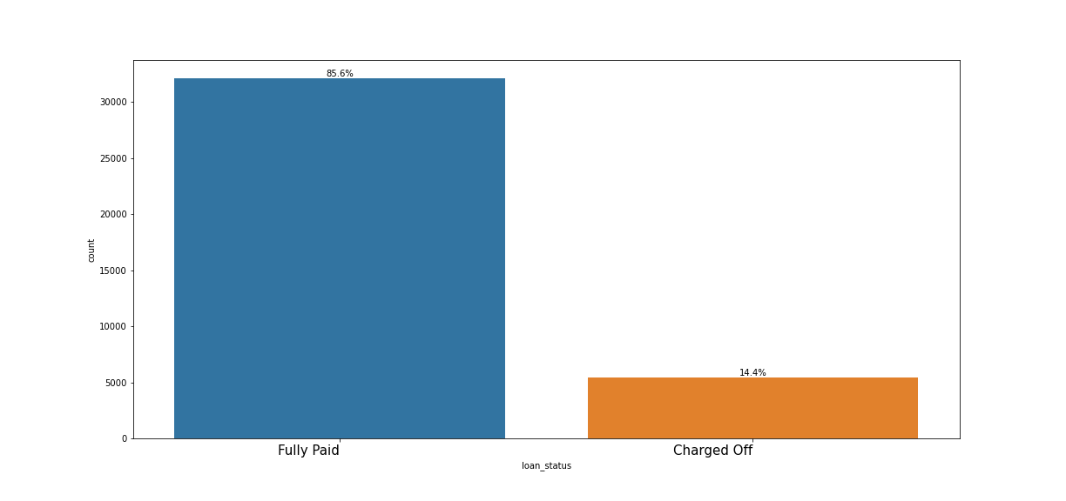
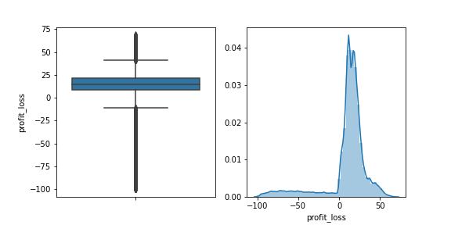
Overview of Lending Club
14.4% of total borrower accounts for defaulter
Average profit is of 9.51%

Slide 9
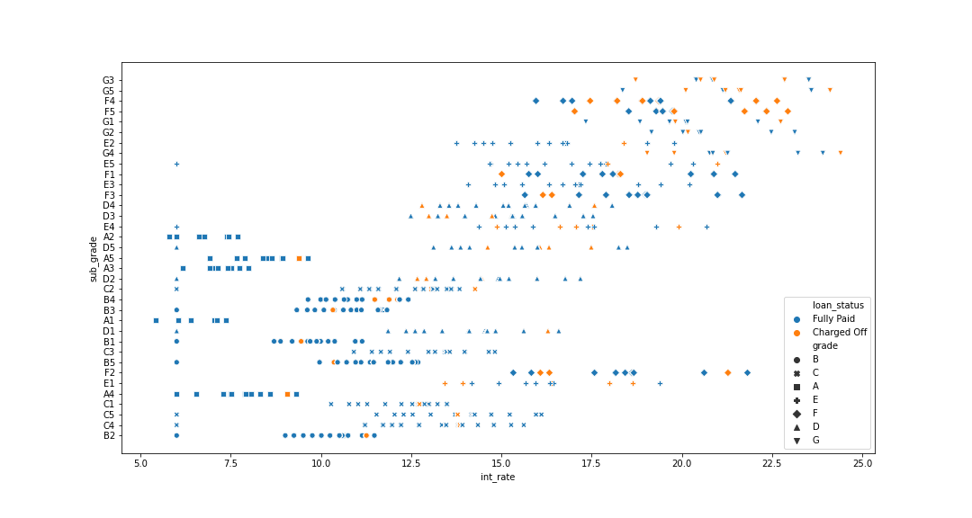
Impact of Interest Rate and Grade
Increasing rate of interest shows more loan defaulter. Loans with greater interest might be a risk.
Lower grade of loan with increasing rate of interest shows higher chances of defaulter.

Slide 10
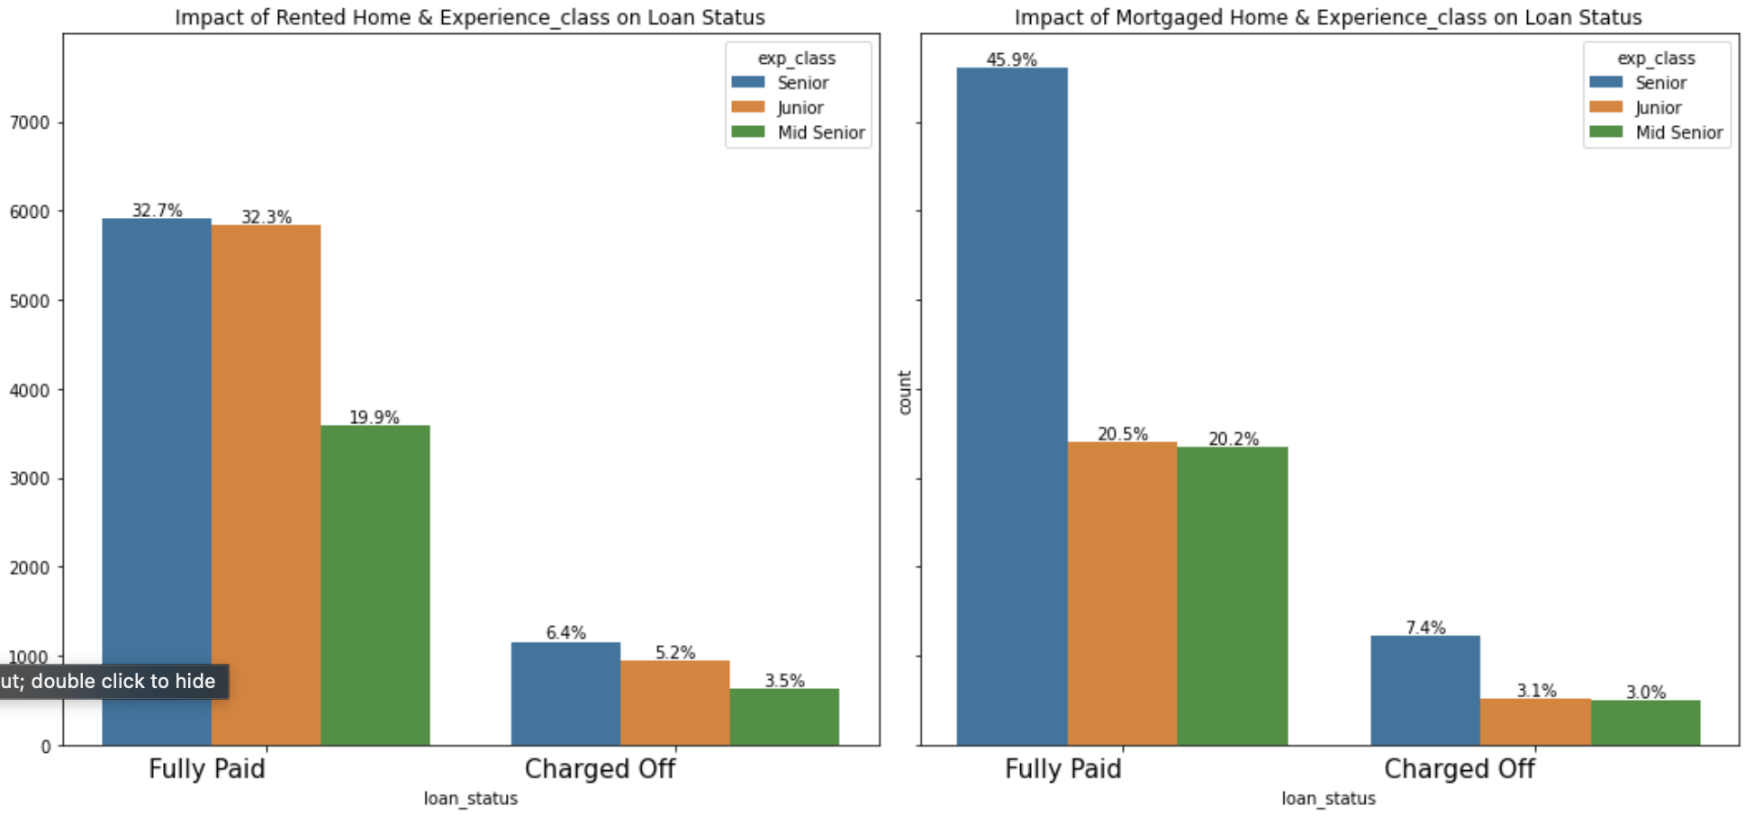
Impact of Homeownership and Experience
Mortgaged and rented homeowners shows a greater number of loan with more defaulters when interest rate is medium to high.
Seniors accounts for more defaults but juniors with rented house also accounts to more default than mortgaged

Slide 11
Conclusion
The provided data has lot of null and missing values. Columns with more that 50% null have been dropped and null have been enriched wherever applicable.
Few of the columns had malformed data. Those were standardized.
Business driven, data driven and type driven derived columns are created as required.
After data understanding and cleanup, univariate and bivariate analysis have been done.
Few of the strong driver variables identified are as follows:
Increasing rate of interest shows more loan defaulter. Loans with greater interest might be a risk.
Number of borrower from CA is most and it also has the highest number of defaulter. Borrower from state CA needs to be scrutinized properly.
Lower grade of loan with increasing rate of interest shows higher chances of defaulter.
Loan with 60 months term shows greater number of defaulter when rate of interest is high.
Mortgaged and rented homeowners shows a greater number of loan with more defaulters when interest rate is medium to high.
most of the people have taken loan for debt consolidation with high interest rate.

